Slide 1



Achal Vikas Gajbhiye
Sustainable Supply Chain Performance

Slide 2

Learning Objectives & Goal
Understand the significance of sustainability in supply chains.
Analyze the role of data visualization in evaluating performance.
Learn how technology aids in addressing supply chain challenges.
To optimize supply chain efficiency while maintaining sustainability.
To minimize costs and carbon footprint in supply chain operations.
To leverage Power BI for insightful decision-making
GOAL
Source :
www.freepik.com/

Slide 3
Tools and Technology used
Power BI: For interactive dashboards and data visualization.
Data Sources: Supplier details, product stock levels, shipping costs, and transportation routes.
Other Technologies: AI and data analytics for trend analysis.

Slide 4
Methodology
Analysis: Evaluated performance metrics such as supplier efficiency, product-wise order quantities, and route optimization.
Data Collection: Gathered data on suppliers, product categories, shipping costs, and transportation methods.
Data Visualization: Built Power BI dashboards to identify key metrics like stock levels, shipping times, and costs.

Slide 5
Problem Statement:
Sum of the product sold by the supplier's name
Average of shipping cost and average of shipping time by the product type
Sum of the stock levels by the product type
Average of Shipping costs by routes
Sum of Stock levels by supplier name
Average of Shipping cost & Average of Shipping time by transportation mode
Sum of Number of products sold by route
Sum of Order quantities by product type

Slide 6
Solution:
Interactive Dashboards: Provide real-time visibility into supply chain metrics.
Supplier Performance Analysis: Identifies top suppliers based on sales and stock levels.
Route Optimization: Minimizes shipping costs by analyzing transportation modes and routes.

Slide 7
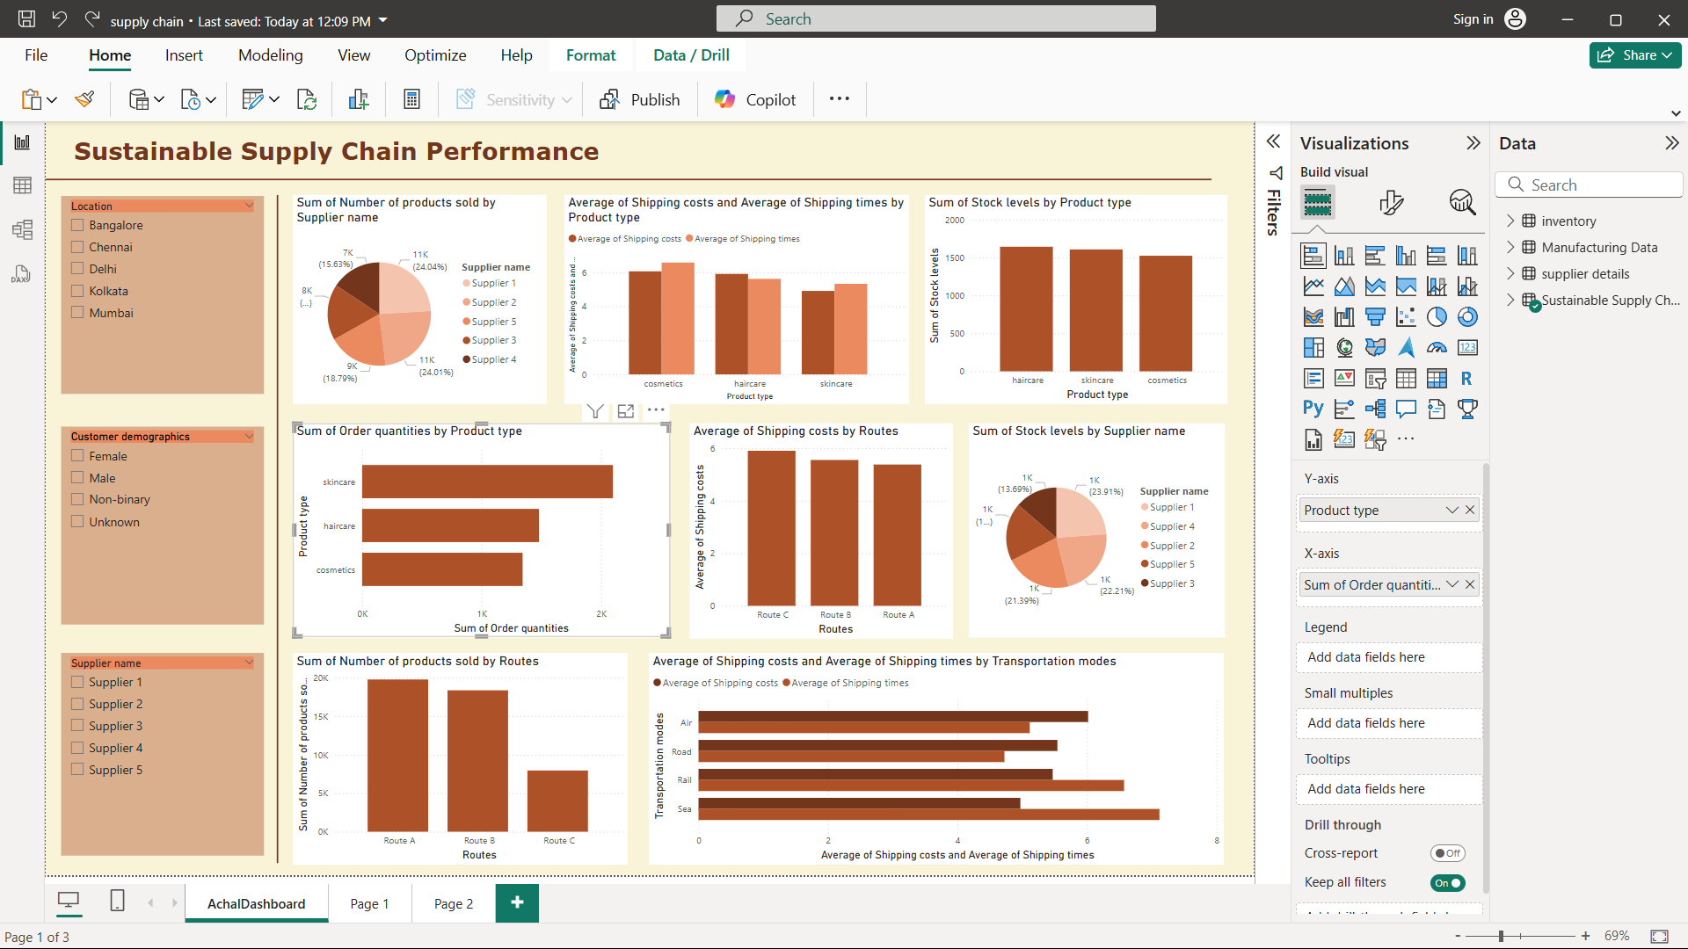
Screenshot of Output:

Slide 8
.
Conclusion:
Leveraging data visualization tools like Power BI simplifies supply chain management.
Sustainable practices can be achieved by optimizing suppliers, routes, and stock levels.
Future Scope: Implement predictive analytics to forecast demand and enhance sustainability further

